Slide 1


The Science of English Bell Ringing
‘’The Art of Change ringing is Peculiar to the English, and like most English peculiarities unintelligible to the rest of the world. To the English Campanologist the playing of tunes is considered a childish game, the proper use of bells is to work out mathematical permutations and combinations.’’
Dorothy L Sayers
With thanks to and acknowledgment of the Association of Ringing Teachers

Slide 2
The science behind the bells
What are they made of?
Are they tuned?
Are they heavy?
How much do they swing?
What makes the noise?
How are they controlled?
Notes:
NOTES FOR PRESENTERS – THE NOTES HERE ARE SUGGESTIONS BUT TRY TO USE YOUR OWN WORDS AND EXPERIENCES AS THE BULLET POINTS COME UP ON THE SLIDE WITH EACH CLICK, NOT JUST READ OUT THE NOTES!
Bells are made from an alloy of copper and tin and are arranged in the tower down the musical scale from the smallest (called the 'treble') to the biggest ('tenor') which has the lowest note. The average tenor weight is 510kg, although they can weigh up to 4,200kg - the weight of a car. Bells are hung within a wooden or steel frame and attached to a wheel. For English change ringing they rotate through 360 degrees, with the 'clapper' (piece of metal) striking the inside of the bell at the end of the swing to sound the note.
A special feature of English bells is that they have a 'stay' which allows them to pause in an up-right position. This means the ringer can control when they strike by pulling them from this 'set' position to swing at the correct time. Within the frame, the bell pivots on the gudgeon as it swings, while the clapper strikes the inside of the bell to make the noise. The rope wraps around the wheel which it is what the ringer below uses to control the bell's swing.

Slide 3
All the bits
Illustration of a bell
Notes:
An illustration of a bell in the ‘down’ position, showing all the different parts that make up the mechanism. The ‘stay’ and ‘slider’ are the key parts that enable the English-style of Change Ringing.

Slide 4
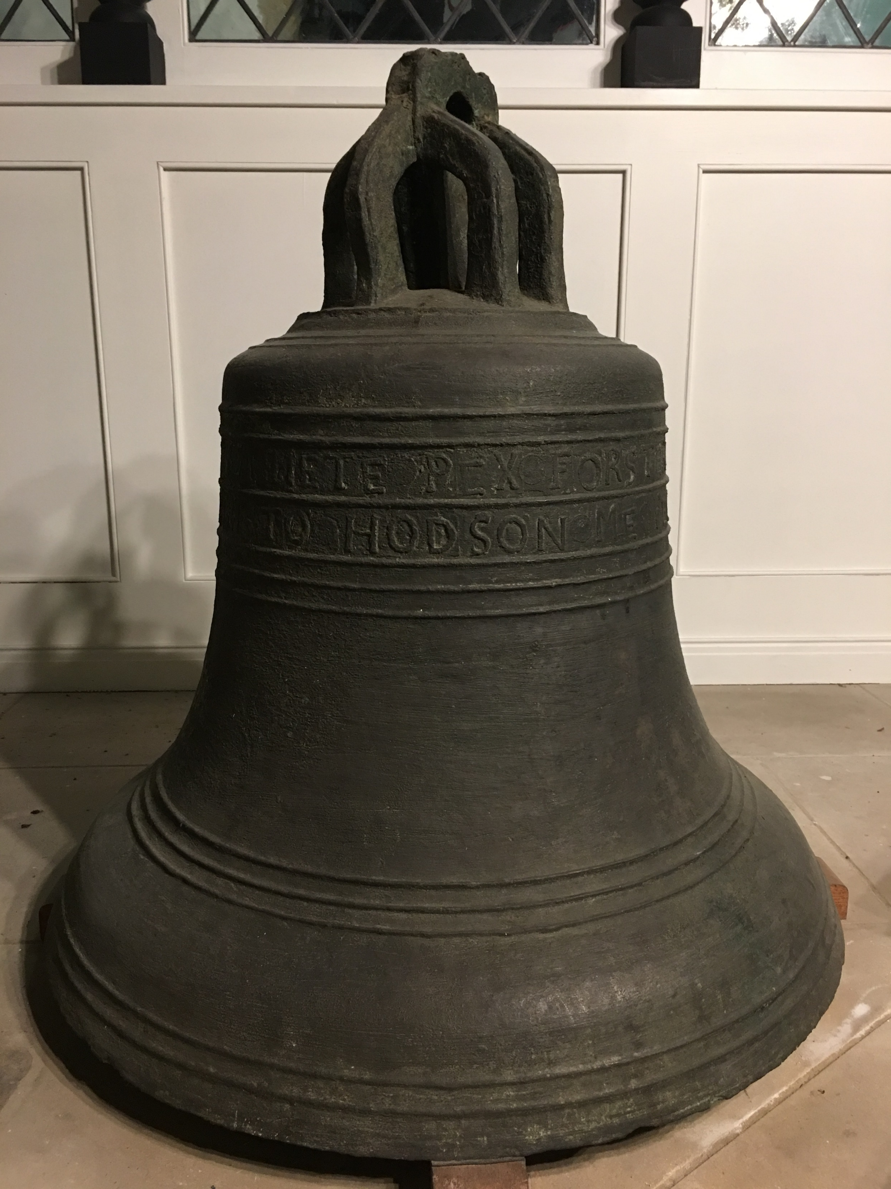
Close-up of the bell*
*Courtesy of St Oswald’s, Durham
Argent
Canons
Crown
Shoulder
Inscription band(s)
Waist
Moulding wires
Soundbow

Slide 5
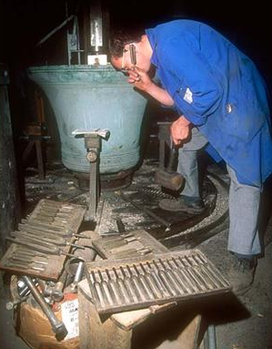

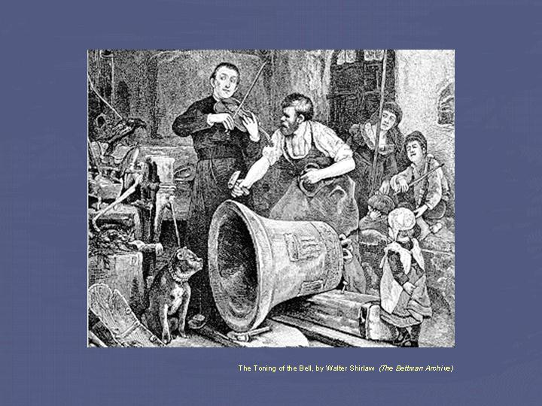
The making of a bell
Casting
Tuning
Notes:
Bells are tuned to one particular note, despite actually producing a range of notes at the same time called harmonics; all of which can be tuned accurately at the time of manufacture. They are tuned by slowly carving metal from the inside of the bell as it is spun round on a special machine.
Bells have been made, or 'cast', in Britain for hundreds of years and, whilst being refined, the process has changed little. Moulds are made of the bells before molten metal is poured in and left to cool. The bells are left to cool for several days, often in pits as has been done for centuries. There are two bell foundries remaining in the UK and it is possible to visit them and have tours of their premises – sometimes even see a casting.
John Taylor & Co, Loughborough www.taylorbells.co.uk
Whitechapel Bell Foundry, London www.whitechapelbellfoundry.co.uk

Slide 6
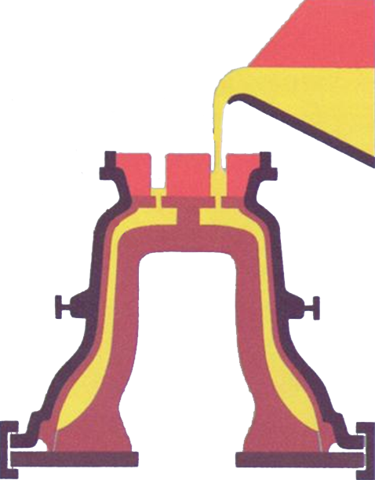
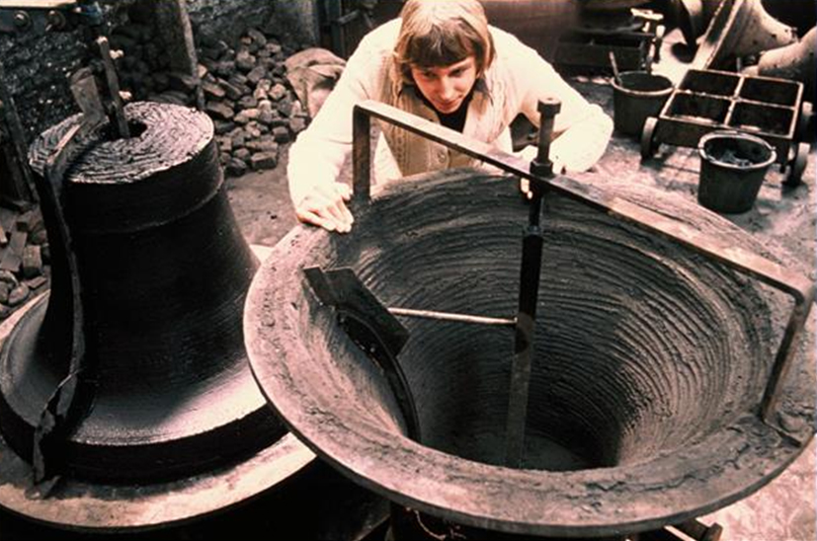
Making the mould
© Whitechapel Foundry

Slide 7
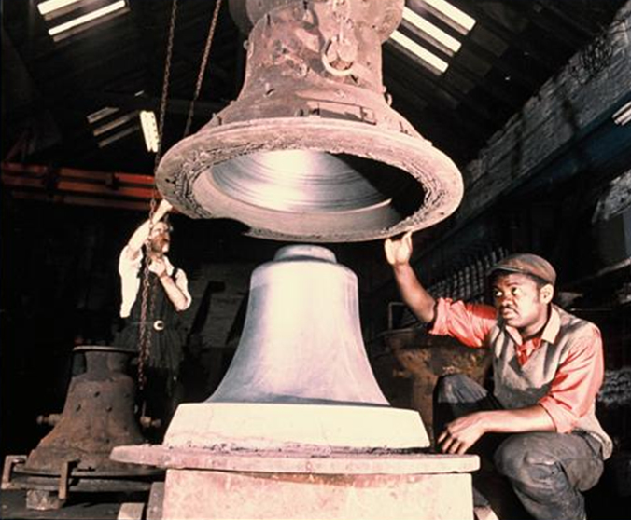
Completing the mould
©Whitechapel Foundry

Slide 8

A 2 tonne bell sounding middle C:

Slide 9
The science/maths behind the ringing
1. Ringing the changes
Notes:
Change ringing is where each time the bells ring they ring in a different order – and this is achieved by pairs of bells changing place in the order they strike. The challenge is to ensure that no ‘change’ is repeated. Here are a few changes on eight bells starting in ‘Rounds’ from the highest pitch and lightest bell (1) to the lowest pitch and heaviest bell (8) - 12345678. With pairs of bells changing place each time three new changes are rung.

Slide 10
2. Ringing more changes
Notes:
The next example (shown) is called Plain Hunt Minor - where 6 bells ring 12 changes beginning and ending in rounds. Ringers do not learn the order the bells ring in each time but the position or place that they have to ring. They do this by memorising the ‘pattern’ or line that the movement of their bell from place to place produces.

Slide 11

Plain Hunt Minor:

Slide 12
How easy?
Quite easy
Not so easy
Notes:
The patterns to remember can be relatively simple, but can also get very long and complicated – even stretching across multiple book pages.
Each ‘method’ will have its own musical qualities and there are thousands of them. If you ring a full Peal in a new method – usually lasting around 3 hours and comprising around 5,000 changes – you are able to name it yourself. Traditionally most are named after places and counties but some are named after months of the year, flowers, elements, people, TV characters – almost anything!

Slide 13
Traditional reporting of peals/quarter peals
Salisbury Diocesan Guild
Swanage, Dorset
St Mary the Virgin
Sunday, 16 November 2014 in 44 mins
1250 Spliced Magic Roundabout Surprise Major
5 Methods - Florence, Dougal, Mr Rusty, Zebedee and Dylan.
Composed by Phil Miles
                1 Bini Miles
                2 Sally Jenkins
                3 Rachael Rutter
                4 Eddie Dicken
                5 Linda Hough
                6 Matthew Pike
                7 Angie Jasper
                8 Phil Miles (Conductor)
Notes:
A peal is a piece of ringing which generally lasts c 3 hours (the time can vary dependent on the size of the bells). A quarter peal therefore lasts c 45 minutes. You can see here how peals and quarter peals are recorded, and many people use a database run by the Ringing World called ‘Bellboard’ to do this. The numbers represent the bells, from lightest (1) to heaviest (8). Often the weight of the heaviest bell is also noted.

Slide 14
Different ways of learning parts which comprise ‘methods’:
Notes:
Ringers learn the different pieces of ‘work’ that each bell has to accomplish and in what order, to make up a method or ‘piece of music’. These pieces of work are given names – places, dodges, Stedman whole turns, points, cats ears, coat hangers and so on to allow easy recognition and retention.

Slide 15
The number of unique changes which can be rung on different numbers of bells:
A peal of 5,040 changes may take between 2.5 and 3.5 hours, depending on the weight of the bells. If you were to try and ring all the possible changes on 12 bells it might take 25 years or more!
Notes:
There are names related to the number of bells which are ‘working’ as part of the tune (eg minor means six are moving places), and the number of changes here is the number before which any particular sequence of bells is repeated. A peal of triples therefore can be rung in its entirety (5,040 changes) without any repetition at all of a particular sequence – mind-boggling maths!

Slide 16
Simulators
Clappers tied
Bells silent
Sensors detect bell swing
Sound heard only inside or on earphones
Public not disturbed!
Notes:
To allow more practice time bells can be tied to stop them ringing and the sound produced by a computer using sensors and speakers. The software for these systems is becoming more sophisticated and can assist with practising many exercises even from early stages of ringing.
It is possible using these systems for virtual ringers to be projected on to a screen for practice or where there are multiple work stations for several ringers to practise at once.
For the more advanced you can practise complex methods on your own, either in the tower on a tied bell, laptop or smartphone.

Slide 17
Safety rules……..
Mainly common sense
Watch out for the ropes
  there’s a ton of metal attached to the top end, swinging through 360 degrees
Only do what is instructed
Notes:
Bells are heavy and it takes skill to manage them safely. There is always the potential for accident - as with many things - but ringing teachers are very aware and will always advise you on how to react safely if you lose control – fortunately a rare event.
Ringers are very safety conscious and will expect certain behaviours. It’s good to have fun but necessary to act appropriately.
1. Never touch a rope unless you are instructed
2. Always check if the bell is up or down
3. Sit with your feet flat on the floor – not crossed legged
4. Wear suitable clothing with no objects (e.g. ties, scarves or jewellery that could
get caught in the rope.
5. Do not distract ringers during ringing
6. Make sure you understand and follow instructions carefully
7. Always tie your rope up when not ringing

Slide 18
We hope you have found this presentation interesting.
For further information please visit: https://cccbr.org.uk/services/pr/

